Slide 1



Business Value :
C-level Persona: CMO / CIO
Industry: CPG / Retail
Primary Solution: SAP Business Data Cloud
Pricing optimization & Promotional effectiveness
Define Promotional campaigns, pricing strategy, its KPIs and maximize profit & volume of sales per promoted product.
SAP Solution:
AI-based recommendations to automate and optimize the pricing process, considering additional data sources like competitor prices, competitor actions, customer demand and data products on SAP BDC as well as custom AI / ML models powered by SAP Databricks, including what-if analysis and revenue & margin simulation on SAC.
“
Accurate
Optimal
“By integrating intelligent technologies into our promotions planning processes, we can reduce residual quantities, minimize waste, and offer customers the goods they actually require in each store.”
Head of Master Data Management and Marketing Processes
More accurate predictions so that all promotional products are available in all stores
Promotion quantities with
self-learning AI models based on daily sales data
60 %
Marketing Head
Heiner
Reduction in time spent on campaign management at stores

Slide 2
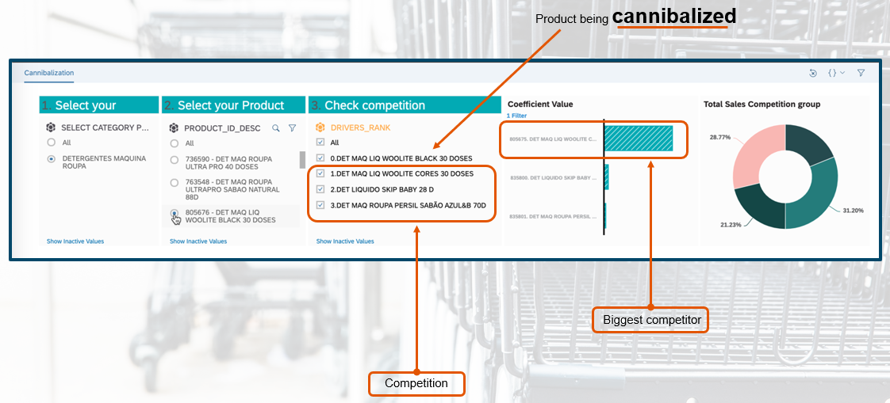
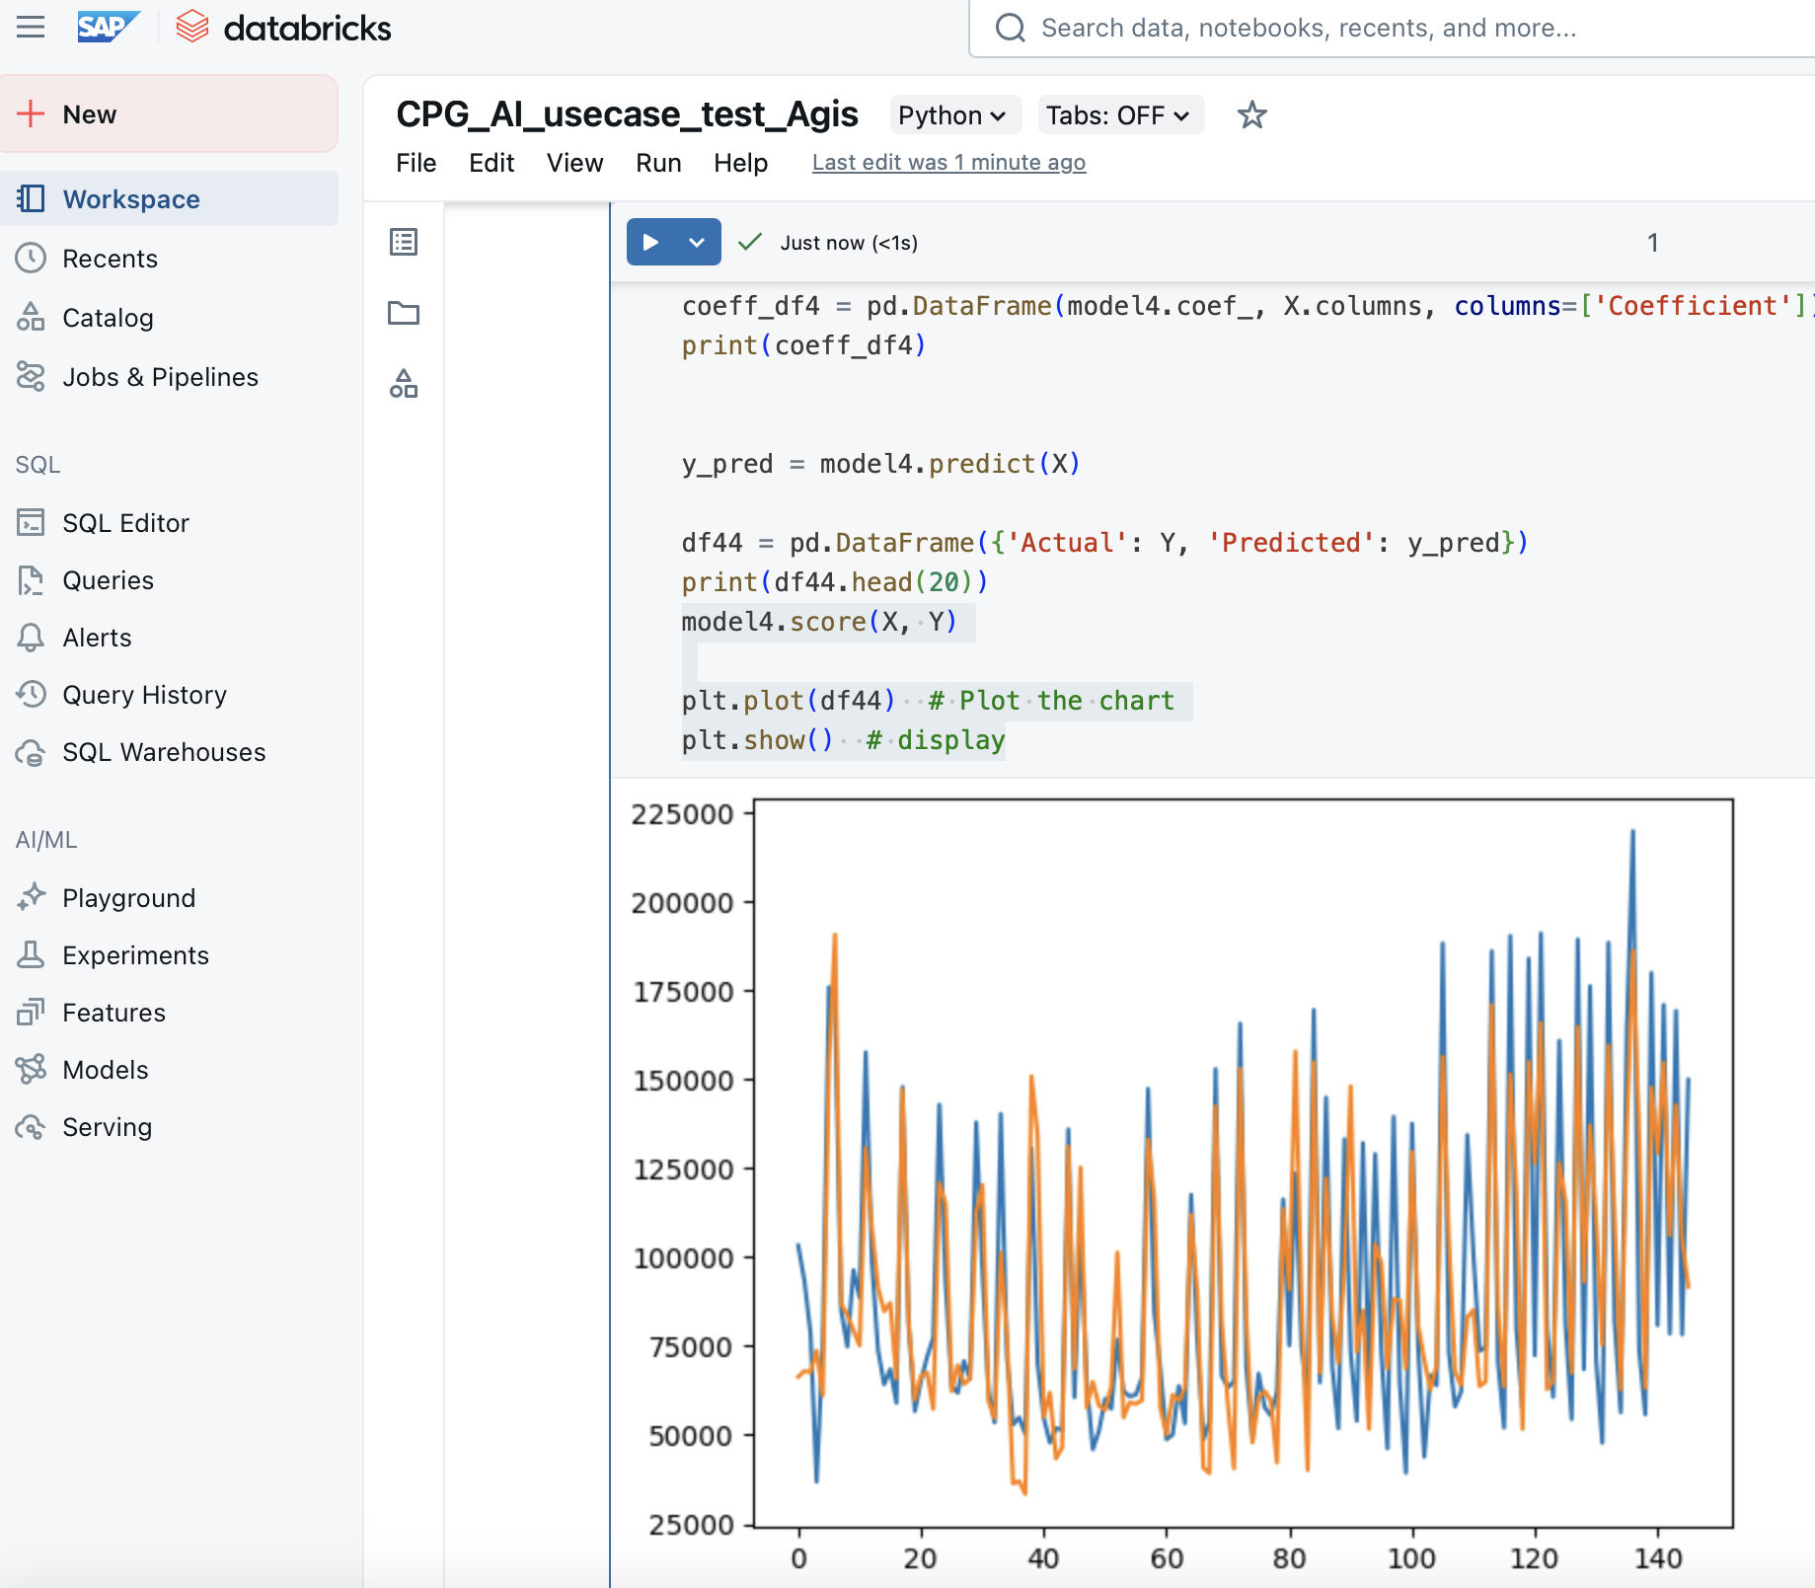

SFSF Joule
Program: SAP Databricks
C-level Persona: CMO / CIO
Industry: CPG / Retail
Primary Solution: SAP Business Data Cloud
Pricing optimization & Promotional effectiveness
Challenge
Difficult to analyze and model multiple promotional effects as well as competition without having the promo calendar and the definition of competitive products beforehand.
Solution
Custom AI model using SAP Databricks, that can be combined with analytical application featuring the capability to model promotional as well as cannibalization effects, to decompose sales into base and uplift and predict sales on promoted/non-promoted products
Value
Powered by:
#1
#2
#3
SAP Databricks
SAP Business Data Cloud
SAP Analytics Cloud
Increase of sales and contribution margin
Decrease of competition between similar products
Optimization of supply according to demand per store and promoted SKU / product
SAP Databricks demo
Learn more

Slide 3


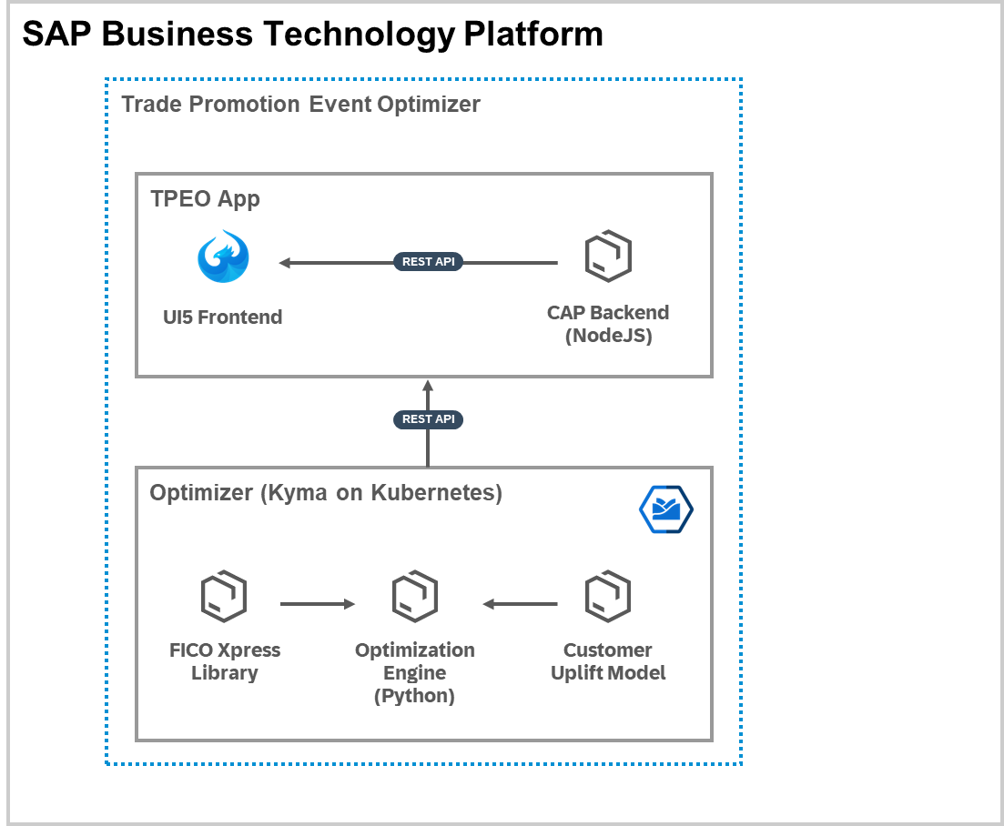



Pricing optimization & Promotional effectiveness
Business Data Cloud & SAP Databricks Architecture
PoC
Optimized Promo Event Recommendations
Key Account Manager
Product
COGs
Baseline Pricing
Retailer
Master Data
ODBC
Business Data Cloud
Datasphere
SAP Databricks
SAP Object Store
Past Promos
Train Uplift Model
Product
COGs
Baseline Pricing
Retailer Data Products
SAP HANA Cloud
Local Table
Views
Object Store
Third Party Data
Delta-share
Notes:
Product Master Data is mainly SAP Data product
COGS and Baseline Pricing is typically Custom data product – either from BW, HANA Cloud (cogs (copa) , pricing (sd) calculations and rules exist typically in S/4 but are mainly customized for every customer)
Retailer Data products – master data of retailers is mainly SAP data product

Slide 4
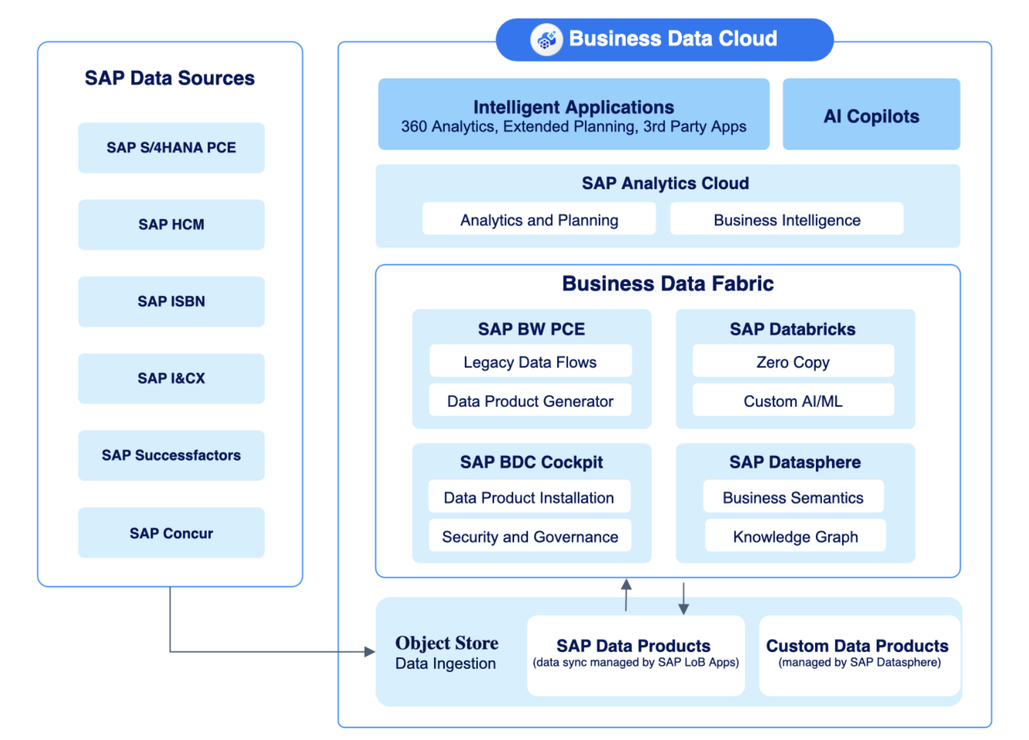
Pricing optimization & Promotional effectiveness
Business Data Cloud & SAP Databricks Architecture
Notes:
Product Master Data is mainly SAP Data product
COGS and Baseline Pricing is typically Custom data product – either from BW, HANA Cloud (cogs (copa) , pricing (sd) calculations and rules exist typically in S/4 but are mainly customized for every customer)
Retailer Data products – master data of retailers is mainly SAP data product

